Slide 1


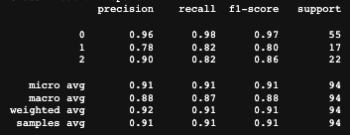
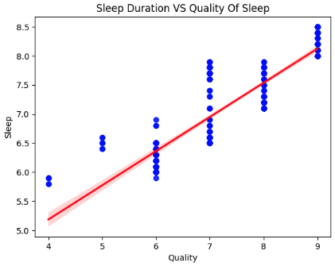
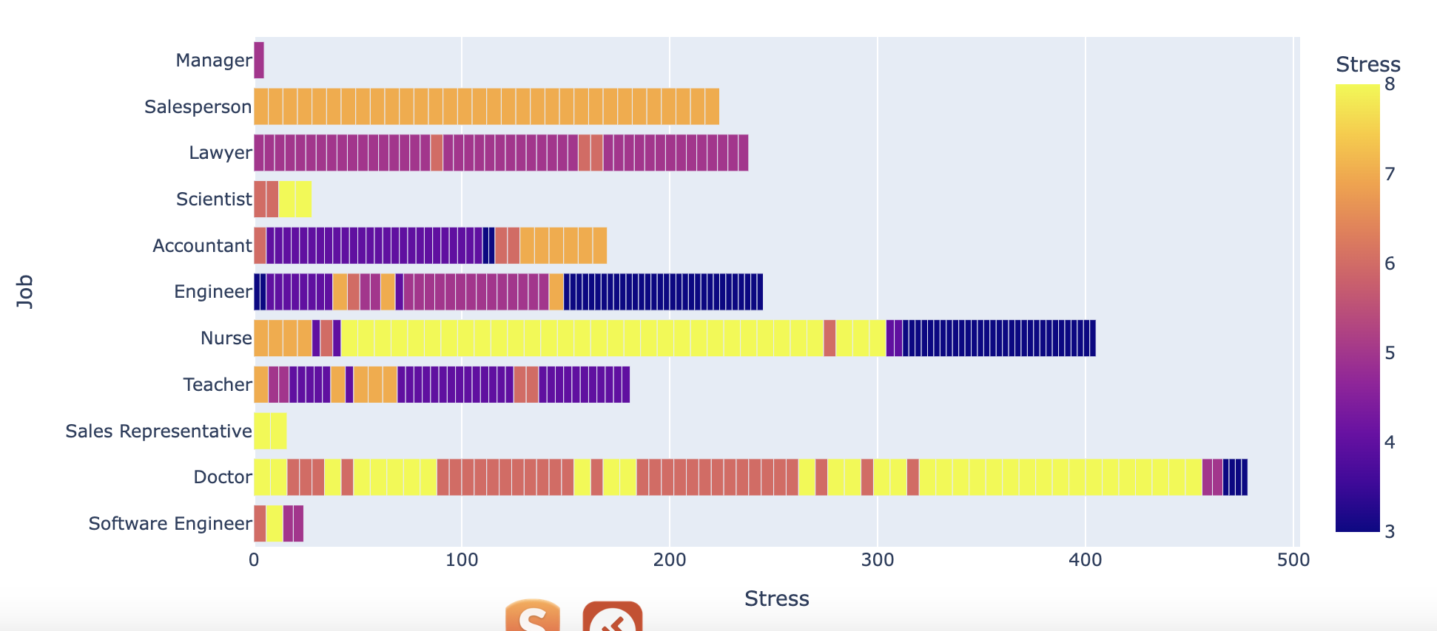
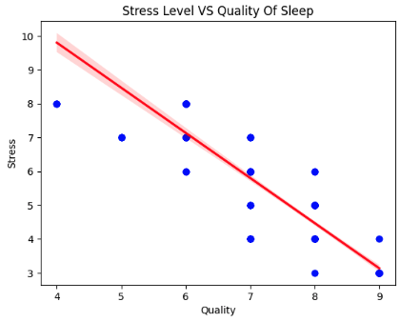
The Sleep Health and Lifestyle
Arthur Verza, CCT College Dublin, May 2024
Arthur Verza , CCT College Dublin, May 2024
ABSTRACT
RESEARCH PARADIGM
FINDINGS
This capstone project explores the relationship between sleep quality and stress levels across various occupations, utilizing a synthetic dataset from Kaggle to analyse how factors like sleep duration, physical activity, and sleep disorders impact overall well-being. Employing machine learning models such as OLS Regression, k-Nearest Neighbours, and Decision Trees, the study identifies significant correlations, with particular emphasis on the adverse effects of high-stress jobs on sleep quality. The findings underscore the potential of targeted interventions in stress management and sleep hygiene to improve health outcomes, providing valuable insights for both individuals and health policymakers.
This scatter plot illustrates the positive correlation between sleep duration and quality of sleep, revealing that individuals reporting higher sleep quality generally experience longer sleep durations. The red trend line emphasizes this relationship, indicating that improvements in sleep quality are often accompanied by an increase in the number of hours slept, suggesting that both duration and quality are crucial for optimal health and well-being.
Reflective Learning
This capstone project has underscored the importance of reflective learning in understanding the complex interplay between sleep quality, stress levels, and lifestyle factors. Through the process of analysing diverse datasets and applying machine learning models, I gained deeper insights into how sleep patterns and stress are influenced by daily activities and job-related demands. Reflecting on the findings has not only enhanced my analytical skills but also emphasized the practical implications of data-driven decision-making in health sciences. This iterative learning approach allowed for continuous improvement in the project's methodologies and outcomes, showcasing the transformative power of reflective practice in educational and professional development.
This decision tree model performance table showcases the effectiveness of our machine learning approach in predicting different stress levels based on variables such as sleep quality, duration, and occupational stress. With high precision in classifying Class 0 (0.96 precision, 0.98 recall) and notable accuracy for Classes 1 and 2, the model demonstrates robust capability in identifying and differentiating between various stress levels. The overall metrics, including a micro average and weighted average precision and recall both exceeding 0.90, highlight the model's general accuracy and reliability in predicting stress outcomes, making it a valuable tool for understanding and mitigating stress-related issues in diverse populations.
RESEARCH QUESTIONS
The three questions below represent the core focus of the entire study:
Q.1. How do different levels of occupational stress impact the quality and duration of sleep among professionals in varying fields?
Q.2. Can machine learning models accurately predict sleep quality based on factors such as physical activity, sleep duration, and the presence of sleep disorders?
Q.3 What interventions can effectively reduce stress levels and improve sleep quality in high-risk occupations?
Stress level Comparison
This bar chart provides a detailed visual analysis of stress levels across various occupations, illustrating the diversity of stress experiences within different job sectors. Each bar represents a specific job title, segmented by stress levels that range from 3 (low stress) to 8 (high stress), with the colours transitioning from purple (low) to yellow (high). The chart reveals that certain professions, such as Doctors and Nurses, experience a wide range of stress levels, while others like Software Engineers and Scientists tend to report lower stress levels. This visualization underscores the crucial role of occupation in influencing stress levels and highlights potential targets for interventions aimed at reducing workplace stress.
CONCLUSIONS
This scatter plot demonstrates a clear inverse relationship between stress levels and the quality of sleep, showing that as the quality of sleep improves, reported stress levels decrease significantly. The trend line highlights a robust negative correlation, indicating that better sleep quality is crucial for effective stress management, thus emphasizing the importance of good sleep hygiene in maintaining lower stress levels and enhancing overall well-being.
A summarised answer to the research questions are presented below:
Q1: Our analysis revealed that professionals in high-stress jobs, such as healthcare and law, report poorer sleep quality and shorter durations compared to those in less stressful occupations like engineering and science. The data suggests that the pressure and demands of certain jobs significantly compromise sleep, highlighting the need for targeted stress management strategies within these fields.
Q2: Yes, the machine learning models implemented, including Decision Trees and k-Nearest Neighbors, have demonstrated high accuracy in predicting sleep quality from the mentioned factors. With precision and recall rates generally above 0.80, these models validate the predictive strength of combining lifestyle and physiological data to forecast sleep quality outcomes effectively.
Q3: Interventions that include flexible scheduling, mindfulness and relaxation techniques, and workplace wellness programs have shown promise in reducing stress and improving sleep quality among high-risk occupational groups. Our study suggests that personalized approaches that address the specific stressors of each occupation, such as workload management for doctors or emotional support for law enforcement, can significantly enhance sleep quality and overall well-being.
OBJECTIVES
The objective of this project is to predict sleep quality and stress levels among individuals and identify the most significant effects of poor sleep quality on daily tasks. By analysing and relating occupation with stress levels, I aim to understand the impact on daily physical activities, sleep quality, and the duration of a night's sleep. Additionally, I will explore how sleep disorders influence sleep quality. The insights gained will help shed light on the correlation between these lifestyle factors and overall well-being.
PROBLEM DEFINITION
When exploring the chosen dataset, I noticed that some occupations interestingly relate to stress levels and other factors such as sleep quality, time spent on physical activity during the day, sleep duration, and whether a person has a sleep disorder. Together, these factors collectively influence a person's stress level.
REFERENCES
Jansen, E. (2020). Sleep 101: Why Sleep Is So Important to Your Health | The Pursuit | University of Michigan School of Public Health | Adolescent Health | Child Health | Chronic Disease | Epidemic | Mental Health | Obesity. [online] sph.umich.edu. Available at: https://sph.umich.edu/pursuit/2020posts/why-sleep-is-so-important-to-your-health.html.
Müller, A.C. and Guido, S. (2016). Introduction to machine learning with Python : a guide for data scientists. First Edition ed. Beijing: O’reilly, p.25.
Ramar, K., Malhotra, R.K., Carden, K.A., Martin, J.L., Abbasi-Feinberg, F., Aurora, R.N., Kapur, V.K., Olson, E.J., Rosen, C.L., Rowley, J.A., Shelgikar, A.V. and Trotti, L.M. (2021). Sleep is essential to health: an American Academy of Sleep Medicine position statement. Journal of Clinical Sleep Medicine, [online] 17(10). doi:https://doi.org/10.5664/jcsm.9476.
Prakash Shyam, Karuppiah . “K Nearest Neighbor - an Overview | ScienceDirect Topics.” www.sciencedirect.com, 2023, www.sciencedirect.com/topics/biochemistry-genetics-and-molecular-biology/k-nearest-neighbor.
Song, Yan-Yan, and Ying Lu. “Decision Tree Methods: Applications for Classification and Prediction.” Shanghai Archives of Psychiatry, vol. 27, no. 2, 2015, pp. 130–5, https://doi.org/10.11919/j.issn.1002-0829.215044.

